Slide 1
Concurrency: Mutual Exclusion and Synchronization
COMP6697001-Operating Systems
Session 6
Dr. Zulfany Erlisa Rasjid B.Sc.,MMSI

Slide 2
Sub topics
- Principles of Concurrency
- Mutual Exclusion: Software Approach
- Mutual Exclusion: Hardware Approach
- Semaphore
- Monitors
- Message Passing
- Producer-Consumer Problem
Readers Writers Problem
System calls

Slide 3
Acknowledgement
These slides have been adapted from: Stallings, W. (2018). Operating Systems: Internals and Design Principles. 9th. ISBN: 978-1-292-21429-0 Chapter 5

Slide 4
Learning Objectives
At the end of this lecture, students are able to:
LO1: Describe different concurrency tehniques
LO2 : Explain the concept of concurrency
LO3 : Compare techniques of concurrency to solve Classical IPC Problem

Slide 5
Multiple processes
Operating System design is concerned with the management of processes and threads:
Multiprogramming
The management of multiple processes within a uniprocessor system
Multiprocessing
The management of multiple processes within a multiprocessor
Distributed Processing
The management of multiple processes executing on multiple, distributed computer systems
The recent proliferation of clusters is a prime example of this type of system
© 2017 Pearson Education, Inc., Hoboken, NJ. All rights reserved.

Slide 6
Concurrency srises in three different context
Multiple Applications
Invented to allow processing time to be shared among active applications
Structured Applications
Extension of modular design and structured programming
Operating System Structure
OS themselves implemented as a set of processes or threads
© 2017 Pearson Education, Inc., Hoboken, NJ. All rights reserved.

Slide 7
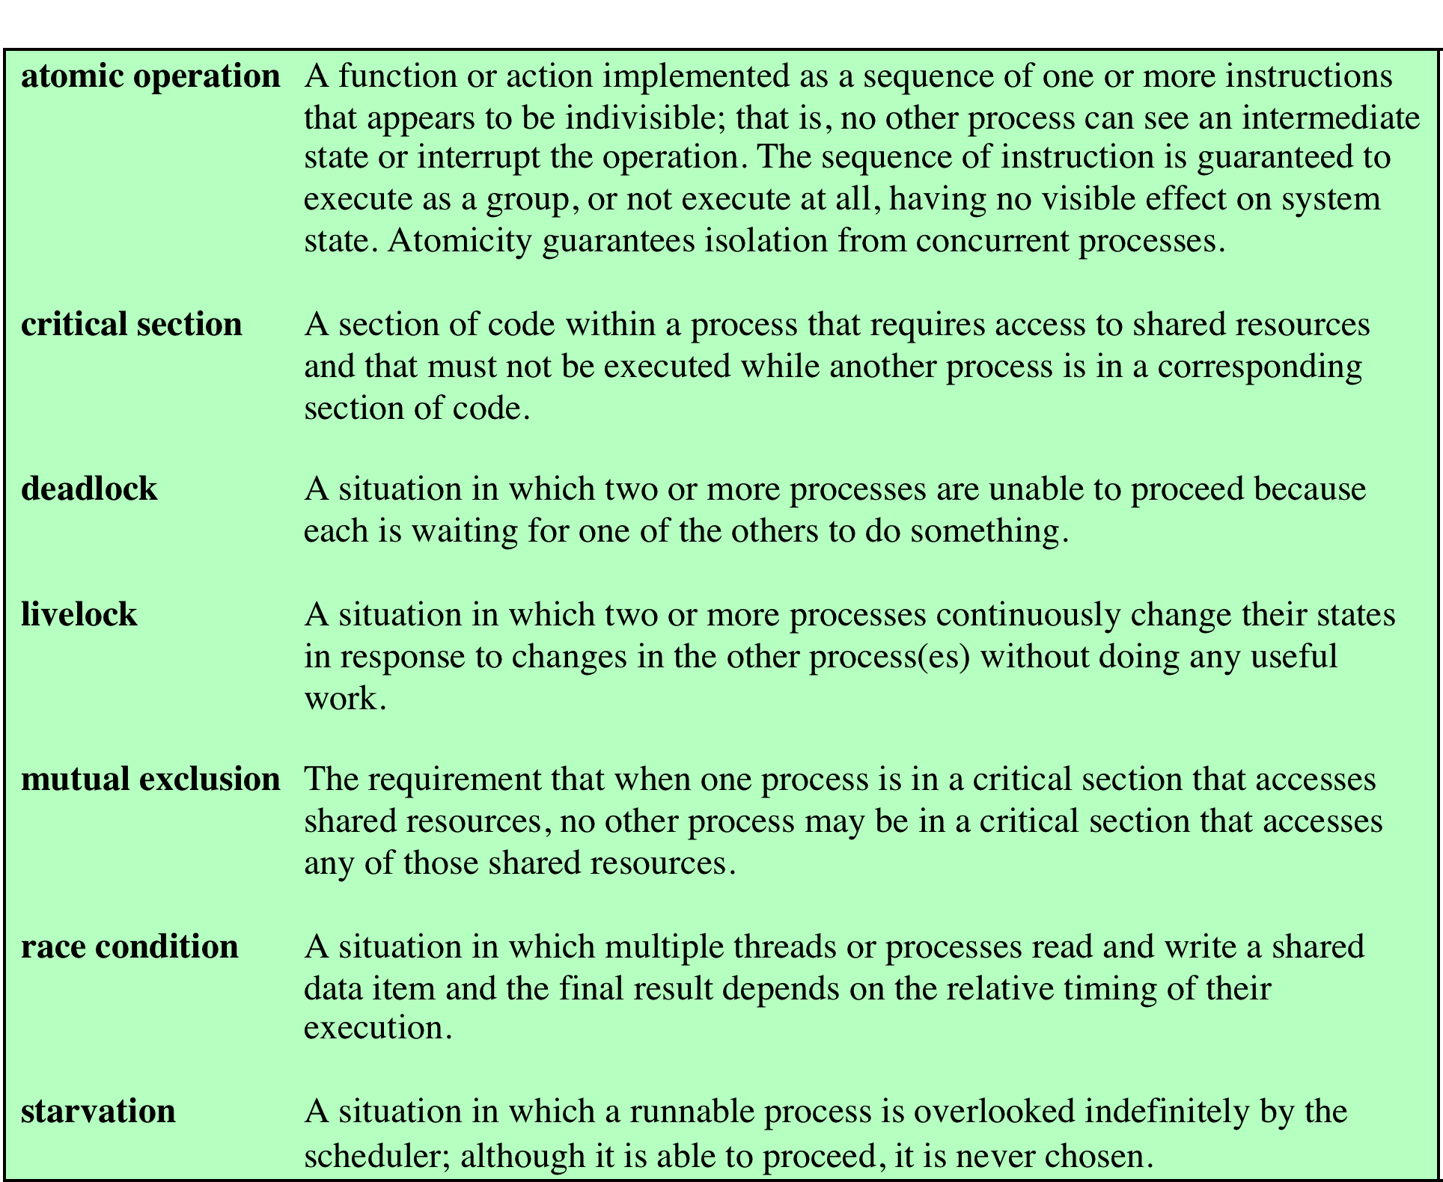
Terms used in synchronization
© 2017 Pearson Education, Inc., Hoboken, NJ. All rights reserved.

Slide 8
Mutual exclusion
Software approaches
Software approaches can be implemented for concurrent processes that execute on a single-processor or a multiprocessor machine with shared main memory
These approaches usually assume elementary mutual exclusion at the memory access level
Simultaneous accesses (reading and/or writing) to the same location in main memory are serialized by some sort of memory arbiter, although the order of access granting is not specified ahead of time
Beyond this, no support in the hardware, operating system, or programming language is assumed
Dijkstra reported an algorithm for mutual exclusion for two processes, designed by the Dutch mathematician Dekker
Following Dijkstra, we develop the solution in stages
This approach has the advantage if illustrating many of the common bugs encountered in developing concurrent programs

Slide 9
Principles of concurrency
Interleaving and overlapping
Can be viewed as examples of concurrent processing
Both present the same problems
Uniprocessor – the relative speed of execution of processes cannot be predicted
Depends on activities of other processes
The way the OS handles interrupts
Scheduling policies of the OS
© 2017 Pearson Education, Inc., Hoboken, NJ. All rights reserved.

Slide 10
Difficulties of concurrency
Sharing of global resources
Difficult for the OS to manage the allocation of resources optimally
Difficult to locate programming errors as results are not deterministic and reproducible
© 2017 Pearson Education, Inc., Hoboken, NJ. All rights reserved.

Slide 11
Race condition
Occurs when multiple processes or threads read and write data items
The final result depends on the order of execution
The “loser” of the race is the process that updates last and will determine the final value of the variable
© 2017 Pearson Education, Inc., Hoboken, NJ. All rights reserved.

Slide 12
Operating systems concerns
Design and management issues raised by the existence of concurrency:
The OS must:
Be able to keep track of various processes
Allocate and de-allocate resources for each active process
Protect the data and physical resources of each process against unintended interference by other processes
The functioning of a process, and the output it produces, must be independent of the speed at which its execution is carried out relative to the speed of other concurrent processes
© 2017 Pearson Education, Inc., Hoboken, NJ. All rights reserved.

Slide 13
Resource competition
Concurrent processes come into conflict when they are competing for use of the same resource
For example: I/O devices, memory, processor time, clock
In the case of competing processes three control problems must be faced:
The need for mutual exclusion
Deadlock
Starvation

Slide 14
Cooperating among processes by sharing
Covers processes that interact with other processes without being explicitly aware of them
Processes may use and update the shared data without reference to other processes, but know that other processes may have access to the same data
Thus the processes must cooperate to ensure that the data they share are properly managed
The control mechanisms must ensure the integrity of the shared data
Because data are held on resources (devices, memory), the control problems of mutual exclusion, deadlock, and starvation are again present
The only difference is that data items may be accessed in two different modes, reading and writing, and only writing operations must be mutually exclusive
© 2017 Pearson Education, Inc., Hoboken, NJ. All rights reserved.

Slide 15
Cooperating among processors by communication
The various processes participate in a common effort that links all of the processes
The communication provides a way to synchronize, or coordinate, the various activities
Typically, communication can be characterized as consisting of messages of some sort
Primitives for sending and receiving messages may be provided as part of the programming language or provided by the OS kernel
Mutual exclusion is not a control requirement for this sort of cooperation
The problems of deadlock and starvation are still present
© 2017 Pearson Education, Inc., Hoboken, NJ. All rights reserved.

Slide 16
Requirement for mutual exclusion
Any facility or capability that is to provide support for mutual exclusion should meet the following requirements:
Mutual exclusion must be enforced: only one process at a time is allowed into its critical section, among all processes that have critical sections for the same resource or shared object
A process that halts must do so without interfering with other processes
It must not be possible for a process requiring access to a critical section to be delayed indefinitely: no deadlock or starvation
When no process is in a critical section, any process that request entry to its critical section must be permitted to enter without delay
No assumptions are made about relative process speeds or number of processes
A process remains inside its critical section for a finite time only
© 2017 Pearson Education, Inc., Hoboken, NJ. All rights reserved.

Slide 17
Mutual exclusion
Hardware support
Interrupt Disabling
In a uniprocessor system, concurrent processes cannot have overlapped execution; they can only be interleaved
A process will continue to run until it invokes an OS service or until it is interrupted
Therefore, to guarantee mutual exclusion, it is sufficient to prevent a process from being interrupted
This capability can be provided in the form of primitives defined by the OS kernel for disabling and enabling interrupts
Disadvantages:
The efficiency of execution could be noticeably degraded because the processor is limited in its ability to interleave processes
This approach will not work in a multiprocessor architecture
© 2017 Pearson Education, Inc., Hoboken, NJ. All rights reserved.

Slide 18
Mutual exclusion
Hardware support
Compare&Swap Instruction
Also called a “compare and exchange instruction”
A compare is made between a memory value and a test value
If the values are the same a swap occurs
Carried out atomically (not subject to interruption)
© 2017 Pearson Education, Inc., Hoboken, NJ. All rights reserved.

Slide 19
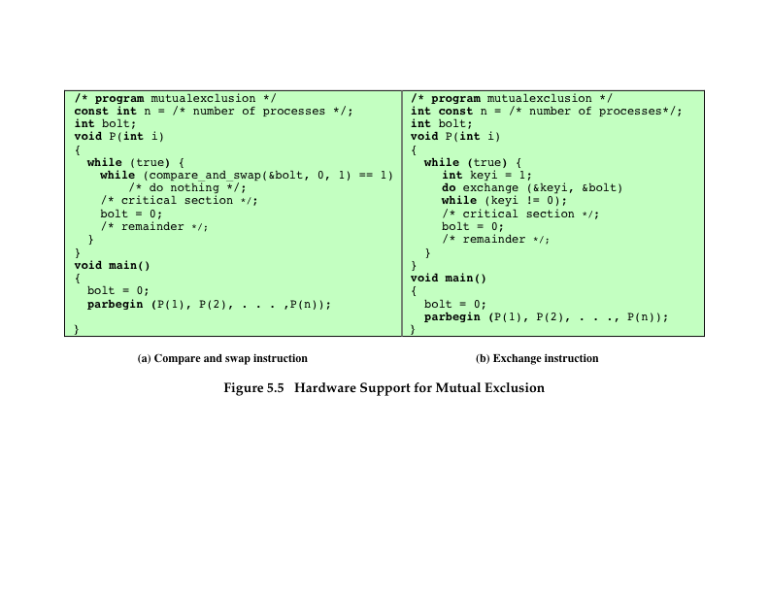
Mutual exclusion
Hardware support

Slide 20
Common concurrency mechanism
© 2017 Pearson Education, Inc., Hoboken, NJ. All rights reserved.

Slide 21

semaphore
A variable that has an integer value upon which only three operations are defined:
There is no way to inspect or manipulate semaphores other than these three operations
A semaphore may be initialized to a nonnegative integer value
The semWait operation decrements the semaphore value
The semSignal operation increments the semaphore value
© 2017 Pearson Education, Inc., Hoboken, NJ. All rights reserved.

Slide 22
consequences
There is no way to know before a process decrements a semaphore whether it will block or not
There is no way to know which process will continue immediately on a uniprocessor system when two processes are running concurrently
You don’t know whether another process is waiting so the number of unblocked processes may be zero or one

Slide 23
Strong and weak semaphore
A queue is used to hold processes waiting on the semaphore
Strong Semaphores
The process that has been blocked the longest is released from the queue first (FIFO)
Weak Semaphores
The order in which processes are removed from the queue is not specified

Slide 24
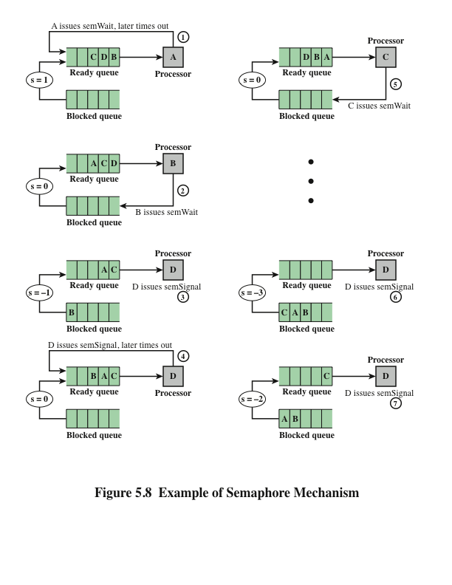
Semaphore mechanism

Slide 25
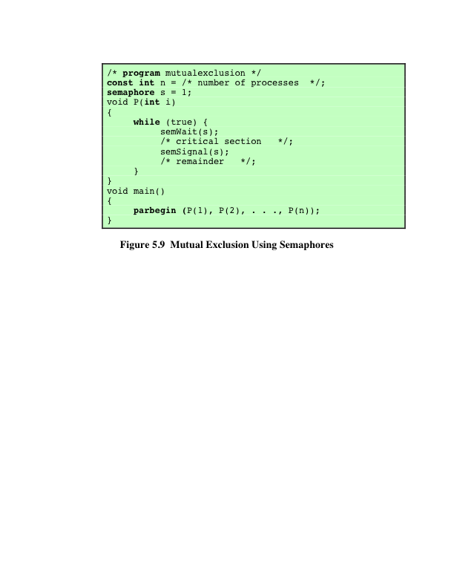
Mutual exclusion using semaphore
© 2017 Pearson Education, Inc., Hoboken, NJ. All rights reserved.

Slide 26
Producer/consumer problem
General Statement:
One or more producers are generating data and placing these in a buffer
A single consumer is taking items out of the buffer one at a time
Only one producer or consumer may access the buffer at any one time
The Problem:
Ensure that the producer won’t try to add data into the buffer if its full, and that the consumer won’t try to remove data from an empty buffer
© 2017 Pearson Education, Inc., Hoboken, NJ. All rights reserved.

Slide 27
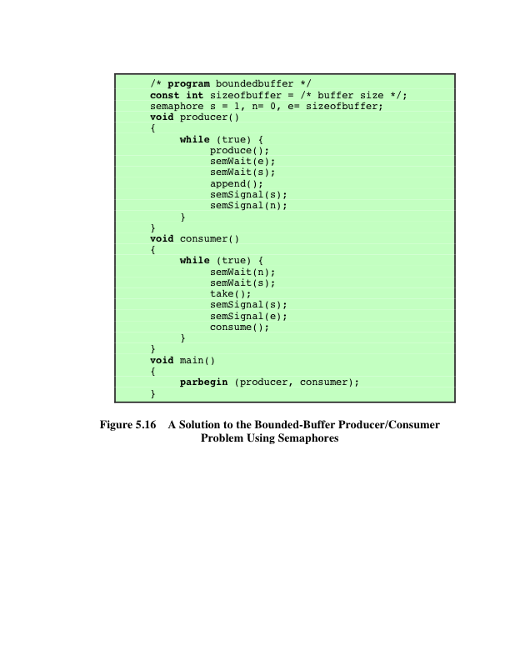
Solution to bounded producer/consumer problem
Using semaphore
© 2017 Pearson Education, Inc., Hoboken, NJ. All rights reserved.

Slide 28
Implementation of semaphore
Imperative that the semWait and semSignal operations be implemented as atomic primitives
Can be implemented in hardware or firmware
Software schemes such as Dekker’s or Peterson’s algorithms can be used
Another alternative is to use one of the hardware-supported schemes for mutual exclusion
© 2017 Pearson Education, Inc., Hoboken, NJ. All rights reserved.

Slide 29
monitors
Programming language construct that provides equivalent functionality to that of semaphores and is easier to control
Implemented in a number of programming languages
Concurrent Pascal, Pascal-Plus, Modula-2, Modula-3, Java
Has also been implemented as a program library
Software module consisting of one or more procedures, an initialization sequence, and local data
© 2017 Pearson Education, Inc., Hoboken, NJ. All rights reserved.

Slide 30
Monitor characteristic
Local data variables are accessible only by the monitor’s procedures and not by any external procedure
Process enters monitor by invoking one of its procedures
Only one process may be executing in the monitor at a time
© 2017 Pearson Education, Inc., Hoboken, NJ. All rights reserved.

Slide 31
synchronization
A monitor supports synchronization by the use of condition variables that are contained within the monitor and accessible only within the monitor
Condition variables are a special data type in monitors which are operated on by two functions:
cwait(c): suspend execution of the calling process on condition c
csignal(c): resume execution of some process blocked after a cwait on the same condition
© 2017 Pearson Education, Inc., Hoboken, NJ. All rights reserved.

Slide 32
Message Passing
When processes interact with one another two fundamental requirements must be satisfied:
Message passing is one approach to providing both of these functions
Works with distributed systems and shared memory multiprocessor and uniprocessor systems
Synchronization
To enforce mutual exclusion
Communication
To exchange information

Slide 33
Message Passing
The actual function is normally provided in the form of a pair of primitives:
send (destination, message)
receive (source, message)
A process sends information in the form of a message to another process designated by a destination
A process receives information by executing the receive primitive, indicating the source and the message

Slide 34
READERS WRITERS PROBLEM
A data area is shared among many processes
Some processes only read the data area, (readers) and some only write to the data area (writers)
Conditions that must be satisfied:
Any number of readers may simultaneously read the file
Only one writer at a time may write to the file
If a writer is writing to the file, no reader may read it

Slide 35
SHARED MEMORY SYSTEM CALL
Create a shared memory object:
Once the object is established, the following function is used to configure the size of the object.
Finally, the mmap() function establishes a memory-mapped file containing the shared-memory object. It also returns a pointer to the memory-mapped file that is used for accessing the shared-memory object.

Slide 36
SHARED MEMORY SYSTEM CALL
example

Slide 37
SHARED MEMORY SYSTEM CALL
example
Abraham Silberschatz, Peter B. Galvin, Greg Gagne (2010). Operating System Concepts 8th ed. With Java. ISBN: 978-0-470-50949-4

Slide 38
signal
Signals are sent to a process, by default most signals cause the process to terminate.
Signals tend to fall into these groups.
Hardware
Software
Input/ Output
Process Control
Resource Control
In order to use signals on a Unix machine you must include <signal.h>

Slide 39
kill
kill() is a utility that allows us to send a signal to a process.
Each signal on Unix has a signal number and even a name.
Format:
int kill(pid_t pid, int sig)

Slide 40
Common signals
Signal Name | Signal Number | Description
SIGHUP | 1 | Hang up detected on controlling terminal or death of controlling process
SIGINT | 2 | Issued if the user sends an interrupt signal (Ctrl + C)
SIGQUIT | 3 | Issued if the user sends a quit signal (Ctrl + D)
SIGFPE | 8 | Issued if an illegal mathematical operation is attempted
SIGKILL | 9 | If a process gets this signal it must quit immediately and will not perform any clean-up operations
SIGALRM | 14 | Alarm clock signal (used for timers)
SIGTERM | 15 | Software termination signal (sent by kill by default)

Slide 41
Signal handler
A signal handler is a normal everyday function. Typically, the signal handler is of the form:
void name(int);
It has no return type and is has one argument - the signal number.
The name of the handler can be anything.

Slide 42
example
#include <iostream>
#include <signal.h>
#include <sys/types.h>
using namespace std;
void siginthandle(int signalx)
{
cout << "Recieved signal " << signalx << endl;
signal(SIGINT, siginthandle);
}
int main()
{
string mystring;
signal(SIGINT, siginthandle);
for (;;)
{
// do something
}
return 0;
}

Slide 43
References
Stallings, W. (2014). Operating Systems: Internals and Design Principles. 8^{th.} ISBN: 978-0-13-380591-8
Abraham Silberschatz, Peter B. Galvin, Greg Gagne (2018). Operating System Concepts 10th ed.
ISBN: 978-1-119-32091-3
A. Tanenbaum and H. Bos (2015), Modern Operating System, 4th
ISBN: 978-0-13-359162-0

